Slide 1


Optimizing for Speed: Advanced JavaScript/CSS Management in DNN
Ian Robinson
Enliven

Slide 2
Why are we here?
Performance is a feature (an important one)
Fast sites lead to satisfied users
DNN was largely optimized on the server side, was not so much on the client side
DNN 6.1+ introduced a new framework for managing CSS and JS

Slide 3
Session Outcomes
You understand
the client resource “problem domain”
the solution foundation built into DNN
why and how to use it going forward
As a developer
As a site administrator

Slide 4
80% of the end-user response time is spent on the front-end.
Most of this time is tied up in downloading all the components in the page: images, stylesheets, scripts, Flash, etc.
Reducing the number of components in turn reduces the number of HTTP requests required to render the page. This is the key to faster pages.
-Yahoo! Exceptional Performance Team

Slide 5
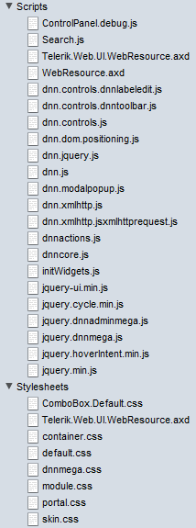
DNN 6.o Resources Overview
Clean install, home page
unauthenticated
6 CSS Files
13 JavaScript Files
Logged in as host
8 CSS Files
22 JavaScript Files

Slide 6
Strategy (DNN 6.1+)
Reduce the file size of each resource
Action: minify content
Only deliver a resource that is needed
Action: Only load files that are requested, only request what is actually going to be used
Reduce the number of resources into as few as possible
Action: file combination
Notes:
Talk about what is and isn’t included in this in DNN 6.1/6.2.
CSS files are automatically included, but there are couple of JS files that aren’t (notably dnn.js, telerik’s JS, and the webforms JS)

Slide 7
Client Resource Management
DNN 6.1.0 – 6.1.5
Settings managed directly in web.config
DNN 6.2+
Settings managed through DNN UI
Host defines defaults
Each site (i.e. portal) can override defaults
All versions
Debug=true in web.config disables combination

Slide 8
Request what is needed
Client Resource Manament
DNN core library used for requesting that a file be loaded
Request a file in code through public API
Or indirectly through a user control
Notes:
Bring up samples of the new API and new user controls
DotNetNuke.Web.Client Assembly
RegisterStyleSheet methods
RegisterScript methods
DnnCssInclude
DnnJsInclude

Slide 9
File Registration: API
Parameters
Page
The current page
FilePath
string - Local file path or absolute URL
Priority
int – relative to other priorities sent in
Provider (location)
string – name of provider to use

Slide 10
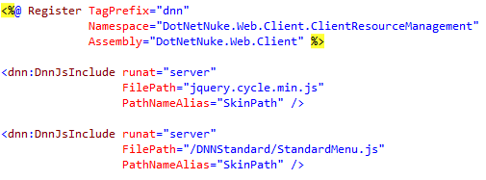
File Registration: Controls

Slide 11
Minify and combine
Sorts through all requests and weeds out duplicates
Handles versioning and caching/persistence as well
Oh yeah, and file ordering too
Notes:
Look at scripts that are sent down to the browser
Talk about file ordering
Integer based relative priority
Reference: DotNetNuke core file order enumeration (spaced by 5)
Talk about caching
ASP.NET Output Caching
MSDN: “On subsequent requests, the page or user control code is not executed; the cached output is used to satisfy the request.”
Stored on disk for persistence across application restarts
Pulled from disk (not rebuilt) and put in cache
Show the compressed static files in app_data

Slide 12
Render on the page
File registration is scoped to page lifecycle
We end up with <script> & <style> actually on the page for requested files.
File placement can be dictated when registering, defaults to the top of the page for compatibility reasons
Notes:
View source and talk about the different locations and why they are there

Slide 13
Details: Versioning
When combining:
Snapshot in time of your CSS/JS files
Version is incremented in the host/admin UI
It is an integer value
Automatically increments when you upgrade an extension or edit portal.css in the browser

Slide 14
Details: Caching & Persistence
When combined
ASP.NET Output Caching
Cache to disk
App_Data\ClientDependency is default

Slide 15
Details: Tips
Priority
Provider
ForceProvider=“DnnFormBottomProvider”
PathNameAlias
SkinPath
SharedScripts
6.1 – json2.js
6.2 – knockout.js, jquery history plugin

Slide 16
6.1 versus 6.2
Web.config - don’t touch in 6.2
Cache busting – not done as frequently in 6.2

Slide 17
Resources
Google “Client Resource Management” and click on the second link. That’s the DNN Wiki.

Slide 18

















Thanks to all our Generous Sponsors!

